Slide 1

Income Statement - Video

Slide 2
Goals:
Introduce the Income Statement
Why it’s useful / limitations
Format

Slide 3
Income Statement
Purpose:
The Income Statement reports the profit generating activities (revenues/gains, expenses/losses) for a specified period.
Income statement equation:
Revenues
- Expenses
Net Income
Notes:
Income Statement summarizes firm performance (the profit generating activities) between Balance Sheet dates.

Slide 4

Income Statement
Usefulness:
Evaluate past performance of the company
Provide a basis for predicting future performance
Help assess the risk/uncertainty of achieving future cash flows
Limitations:
Companies omit items they cannot measure reliably
Income is affected by the accounting methods employed
Income measurement involves judgment
Notes:
Usefulness:
Can evaluate past performance 2. Can provide a basis for predicting the future,
Compare to prior year’s and to competitor’s performance identify trends that may continue into the future
Increasing revenue
Shrinking margins
3. Can help assess the risk or uncertainty of future cash flows
Segregating continuing operations from non-recurring sources
Limitations:
Items that cannot be measured reliably are not reported
Most unrealized gains
Changes in brand recognition, customer service
Income numbers are affected by the accounting methods employed
Straight line versus accelerated depreciation. Both methods are allowed and Net income will differ.
Income measurement involves judgment & estimates
Same asset, Company A estimates 10 year useful life, Company B estimates a 12 year life. Both allowed, net income will differ.

Slide 5
Multiple-Step vs. Single-Step
Single Step
2 Broad classifications
Followed by income tax and
the bottom line
Notes:
Income statements come in 2 varieties:
The single step presents two broad classifications
Revenues and gains
Expenses and losses
Followed by income Tax
The difference between a Revenue & a gain or an Expense and a loss .
If the goods or service that we sold is a primary operation, we’ll call it Revenue.
Let’s look at this example. Just by the magnitude of the numbers we can see that the interest revenue is NOT a primary operation for this company. (it’s $3,000 compared to Sales rev of 1M.
Companies are going to receive assets for sales of things outside of the principle activities of the firm.
(for example, they might sell an old company car). Assume a company is not a car dealership; and yet they happen to sell a car, that should be classified as a Gain of sale of an asset for example.
Same concept applies with expenses, if a cost is incidental to the company and not related to primary operations,
It might be more properly classified as a loss (instead of an expense).
Now, for the Single Step Income Statement, Revenues & Gains are clumped together. Expenses &Losses are also grouped together.

Slide 6
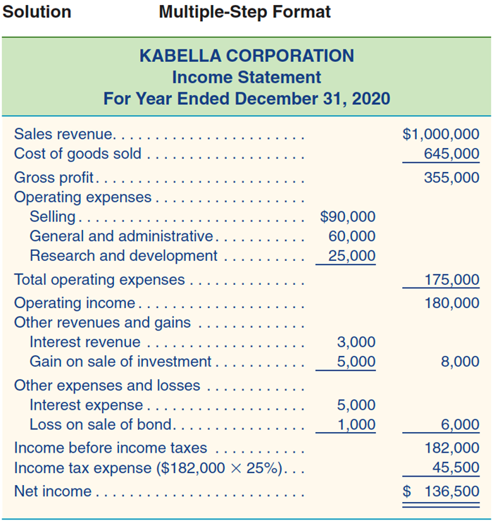
Multiple-Step vs. Single-Step
Multiple-Step
Separates operating and nonoperating items
Typically presents:
Gross profit
Operating items
Nonoperating items
Followed by income tax
and the bottom line
Notes:
You might notice that the Multi Step Income Statement organizes the same exact material a bit differently.
As a matter of fact
The most important information (for predicting future performance) is going to be at the top.
You know how we, as humans, can get bored reading anything technical in nature, Readers are likely to find the most relevant information toward the top of the document.
This is ASIDE from the absolute bottom line, (Net Income), and EPS
Our Non-Operating Items (these are the company’s non-primary, incidental or peripheral activities) often are conveniently identifies as “Other”
Now, these may occur year after year (for example interest expense on a loan).

Slide 7
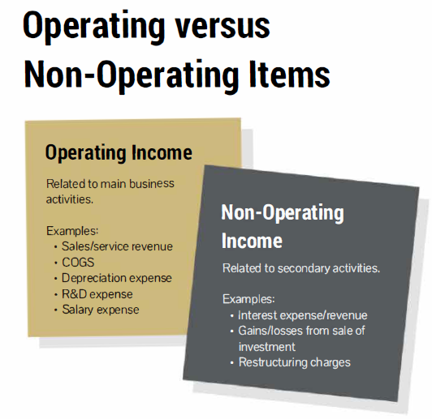

Slide 8
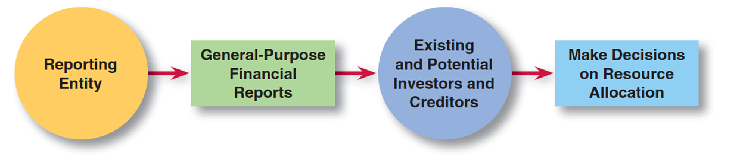
Why we like the Multi-step
Separates operating from nonoperating transactions.
Matches costs and expenses with related revenues. (i.e. right after Sales we see the Cost of those Sales)
Highlights certain components of income that analysts use assessing financial performance. For example: Gross Profit or Operating Income.
Reliable financial information helps users to make more informed decisions on resource allocation.
Notes:
We like the Multi Step because the information provided, and its presentation, can better achieve the goal of financial reporting.
The goal of financial reporting (from Chapter 1):
to prepare the financial statements for external users like investors and creditors
so they can make informed decisions about where to allocate their resources (that is, invest their money).
Investors/creditors are interested in future performance,
the rundown of activity in a multi-step income stmt is organized to assist readers in grasping what activities are likely to occur again versus those that are not

Slide 9
“Format” requirements
Ordering of items (revenue, COGS, operating expenses, non-operating exp., income before tax, tax, income)
Which line items must be separated (e.g., tax expense, material items)
Required sub-totals (e.g., income before tax)
Which items must/can be “prominently” displayed
Net of tax (e.g., discontinued operations)
Per share amounts presented

Slide 10
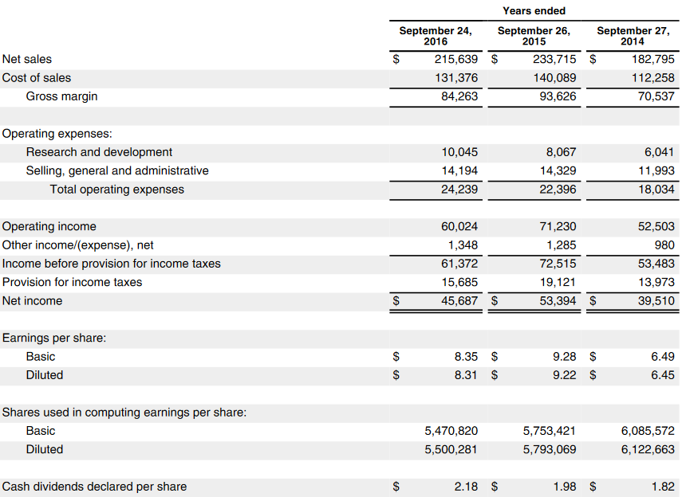
Income Statement (Apple 2016)
https://www.sec.gov/Archives/edgar/data/320193/000162828016020309/a201610-k9242016.htm
Notes:
SEE SEC.GOV
Firms often similar goals (maximize total profits) but different strategies.
Example: Walmart vs Tiffany (low margins/high volume vs. high mark-ups/low volume) − if didn’t already in Class 2
Walk through IS:
Comparative IS with 3 years
GP is also known as Gross Margin
EPS is the earnings per common shareholder, discussion coming soon – featured in video 2
We know the IS is the first fin stmt prepared as we need the Net Income number to calculate the final Retained Earnings number that appears on the Balance Sheet, if we move to the corresponding Balance Sheet

Slide 11
Closing Thoughts
Presents results of operations for a period of time (revenues and expenses)
Material items are presented separately
Multi-step separates by operating and non-operating
A few required lines (income before tax, tax, income)

Slide 12
Income Statement - Video

